Slide 1
Elimination
ZeroTechno

Slide 2
Introduction
This program is needed to automatically solve systems of linear equations using the elimination method, reducing manual errors and long calculations for 2-variable and 3-variable systems.
It works by letting the user input coefficients, choose the number of variables, and then applying pure elimination step by step to remove variables one at a time.
The program clearly shows each elimination step, computes the final solution, and verifies the results, making it useful for both learning and checking answers.

Slide 3
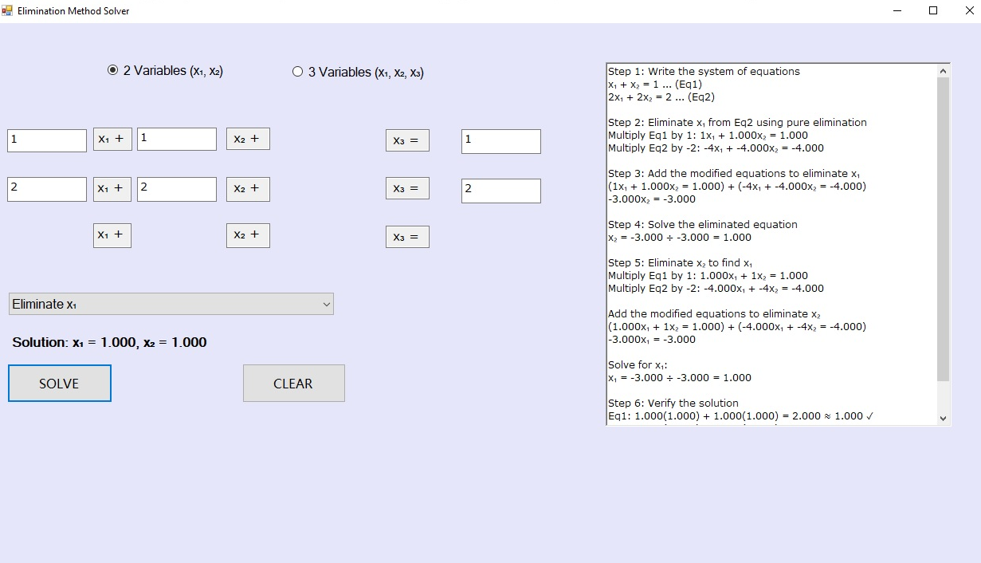
Full view of Program

Slide 4

The process of the Program
The user must first select whether the linear system is composed of 2 variables or 3 variables.

Slide 5
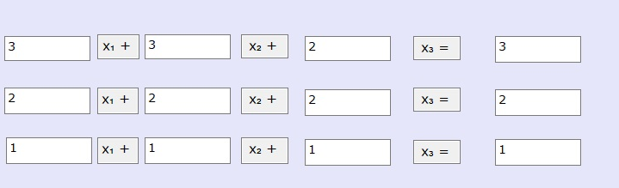
The process of the Program
The user must then input the values within the white boxes that they want for the linear system to solve.

Slide 6

The process of the Program
The user must then select whether to eliminate X1, X2 or X3 by choosing with the box below.

Slide 7

The process of the Program
After selecting which X to eliminate, the user must then choose whether to solve or clear the given linear equation.

Slide 8
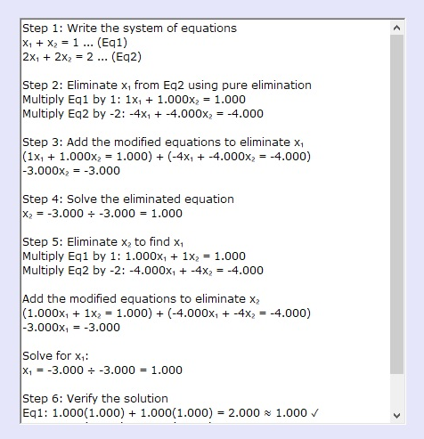

The process of the Program
If the user selects solve, the box on the right of the system will then show a step-by-step guide on how to solve the given linear equation and also give its answer above the solve box that was mentioned previously.

Slide 9
End of Presentation

